Slide 1
Try these questions
Why would a cell need to divide?
What is the scientific name for 'cellular division?'
Name the phases of the cell cycle. Which phase do cells spend most of their time?
How is cancer related to cell division?

Slide 2
The Cell Cycle and Mitosis

Slide 3
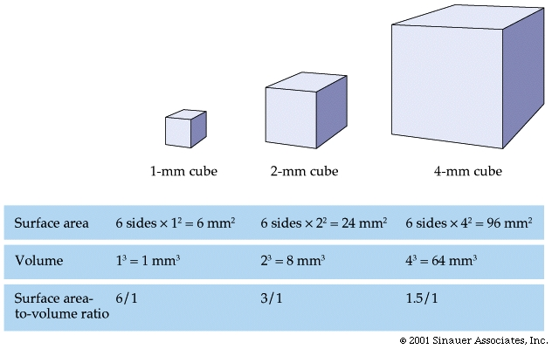
Why do cells divide?
A. Large cells are inefficient
The process of diffusion takes too long in large cells
-Nutrients, wastes not obtained/released efficiently
B. DNA cannot provide enough instructions in large cells
C. Large cells
require too much energy
build-up too much waste
A cell's volume increases faster than its surface area!

Slide 4
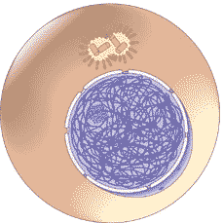
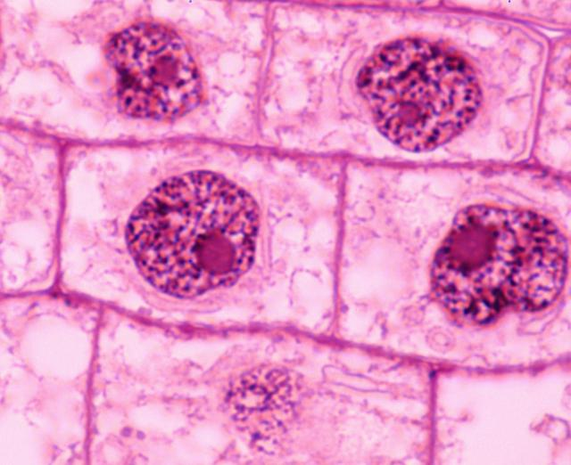
II. The Cell Cycle: Interphase and Cell Division (Mitosis)
1. Interphase:
A. G1: The cell grows, metabolizes, carries out normal functions
B. S: DNA replication, proteins synthesized
C. G2: Organelles are replicated, to prep for division
2. Cell Division: (Mitosis)
A. Prophase, Metaphase, Anaphase, Telophase "PMAT"
B. Cytokinesis (kinesis = "break")

Slide 5
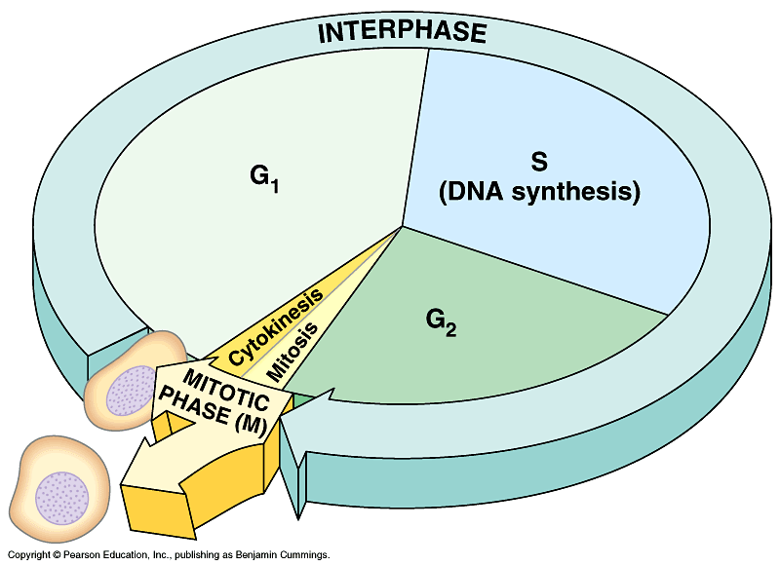

Slide 6
Phases
Prophase: 20+ Minutes
First and longest phase
Chromatin coils into chromosomes
Nucleolus & Nuclear Membrane begins to disappear
Centrioles begin to migrate to opposite ends of the cell
Spindle fibers/apparatus begins to form

Slide 7
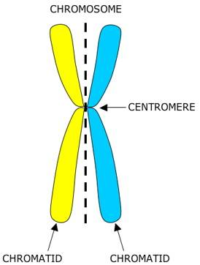
Wait a minute…chromosomes?
What is a chromosome and sister chromatid?
Each vertical side is a replication of the original DNA connected by the centromere.
Each half is called a sister chromatid.
The entire structure is called a chromosome.

Slide 8
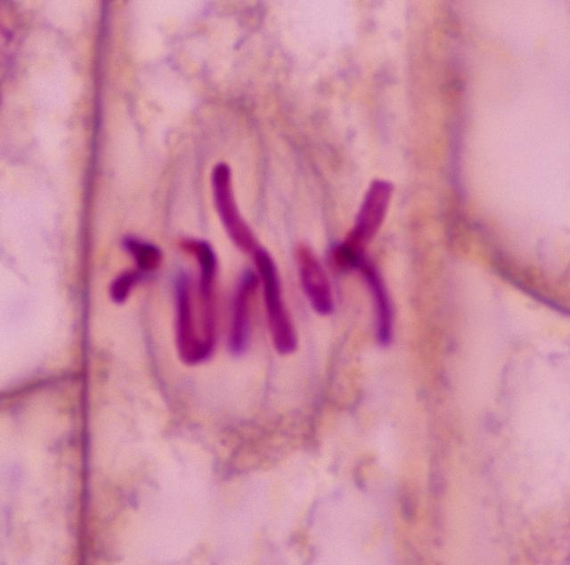
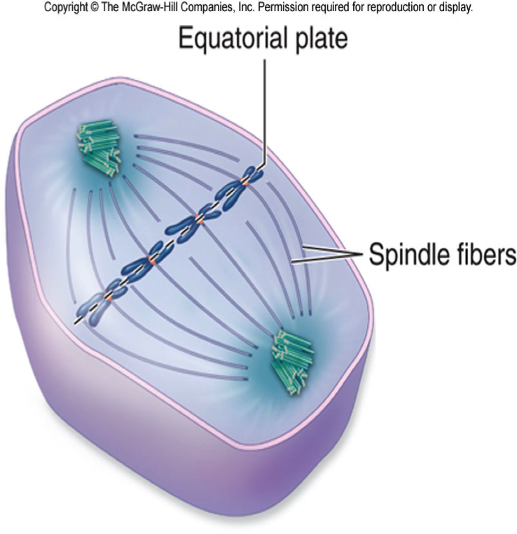
metaphase
Sister chromatids attach to spindle fibers in preparation of being separated
Chromosomes line up on the equator (middle) of the spindle/ cell
Each chromatid is attached to a separate spindle fiber by its centromere

Slide 9
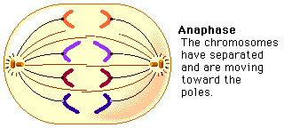
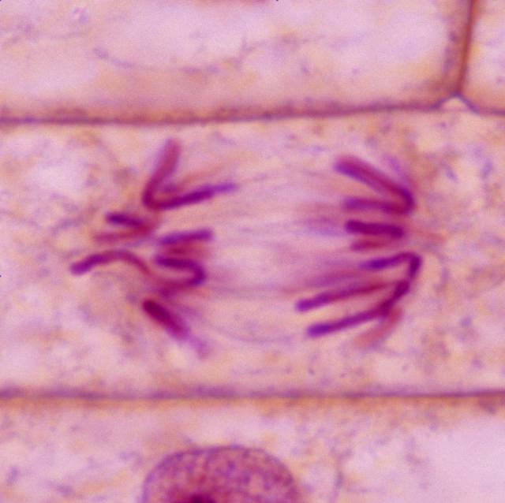
Anaphase
Centromeres split apart
Sister chromatids separate as the spindle fibers contract and breakdown
Sister chromatids begin to migrate to the poles

Slide 10
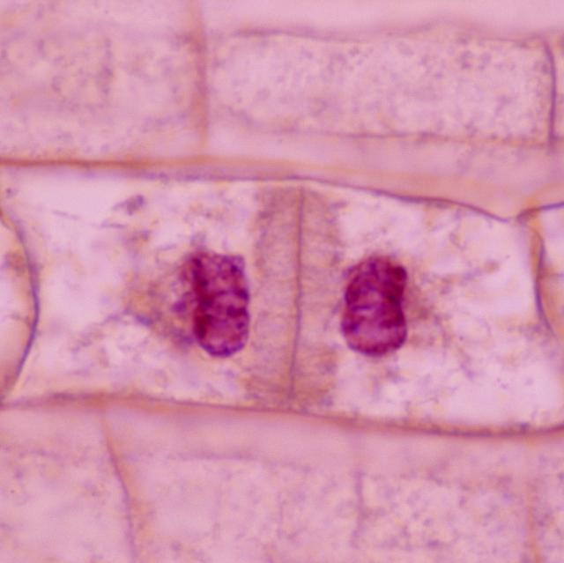
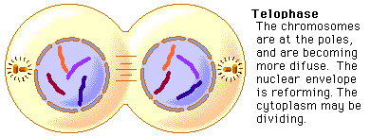
telophase
Begins when sister chromatids reach the opposite poles of the cell
Chromosomes (sister chromatids begin to unwind)
Spindle fibers breakdown
The nucleolus and nuclear envelope reappear
The cell's plasma membrane begins to separate the two new nuclei

Slide 11
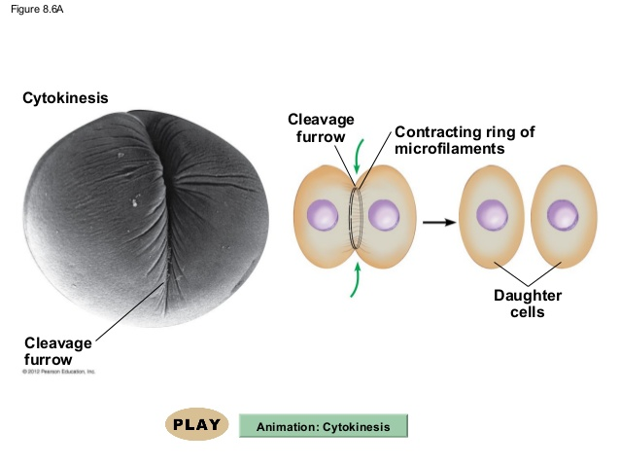
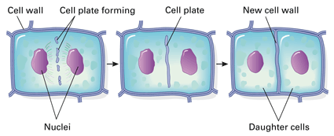
Cytokinesis – splitting!
The cell's cytoplasm divides
In animal cells, the membrane pinches-in forming at a cleavage furrow, forming two new cells
In plant cell's the cell plate forms across the cell's equator, building a new cell wall
Two new, duplicate cells result

Slide 12
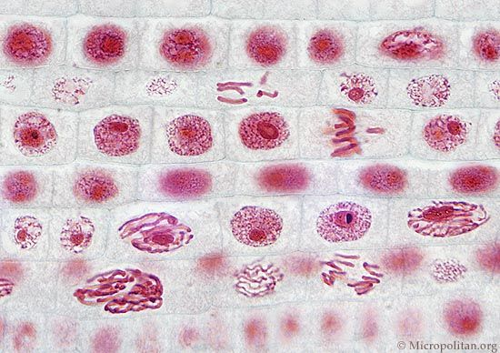
Interphase
prophase
metaphase
anaphase
telophase
Total counted:
Which phase does a cell spend most of its lifetime?
Notes:
Ask students to write down the phases, and tally how many cells they see in each phase.

