Slide 1
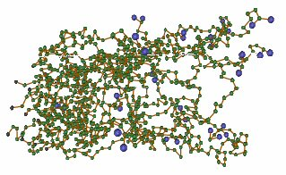
Macromolecules:
Giant Molecules of Living Matter
Image Source: http://polymers.case.edu/images/polymers.jpg

Slide 2
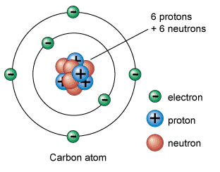
Atoms – The basic unit of matter
Subatomic Particles:
Electrons
Protons
Neutrons
Valence electrons
Available for the use of bonding (to establish stable molecules)

Slide 3
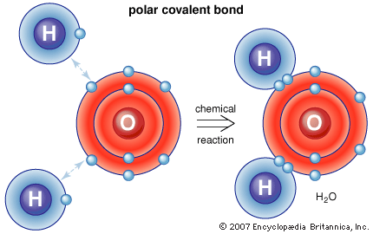
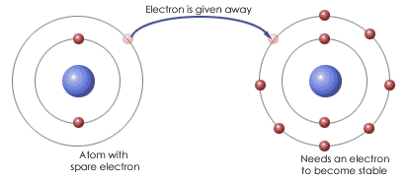
Bonding
Covalent:
Sharing e-/Stronger
Ionic:
Transferring e-/Weak
Molecules/Compounds are formed through bonded atoms.
Mixtures/solutions
Solution=solvent+solute

Slide 4
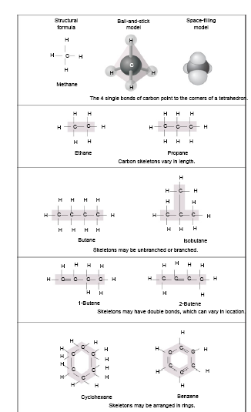
CARBON
Carbon atoms are the most versatile building blocks
They have 4 valence electrons
Carbon skeletons are very diverse
Life’s molecular diversity is based on the properties of carbon.
Campbell Figure 3.1
Notes:
Can for single bonds, double bonds and triple bonds
Rings often written without C- understood there is a C there

Slide 5
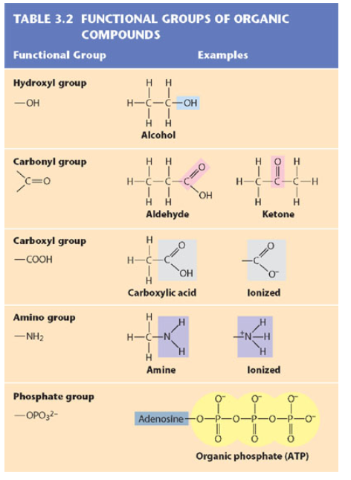
GROUPS
FUNCTIONAL

Slide 6
Macromolecules
Giant molecules in living things made from 1000’s of smaller molecules.
Formed by the process of polymerization.
Small molecules called monomers are joined together to form polymers
Dehydration Synthesis
2 molecules covalently bonded through the loss of a small molecule usually water.
1 molecule loses a –OH the other loses an +H
Enzymes are necessary for the reaction to occur

Slide 7
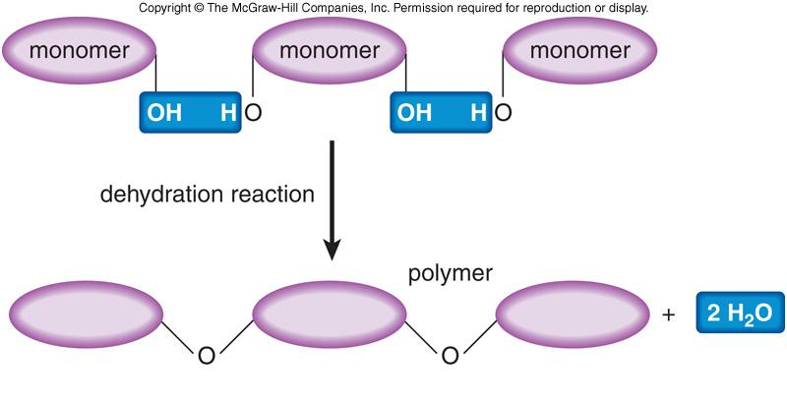
Dehydration Synthesis

Slide 8
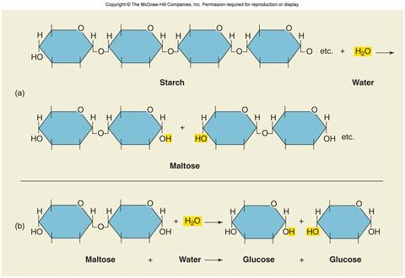
Hydrolysis polymers are broken down into monomers

Slide 9
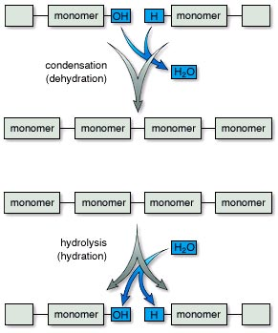
Dehydration vs. Hydrolysis
Notes:
Copyright © The McGraw-Hill Companies, inc

Slide 10
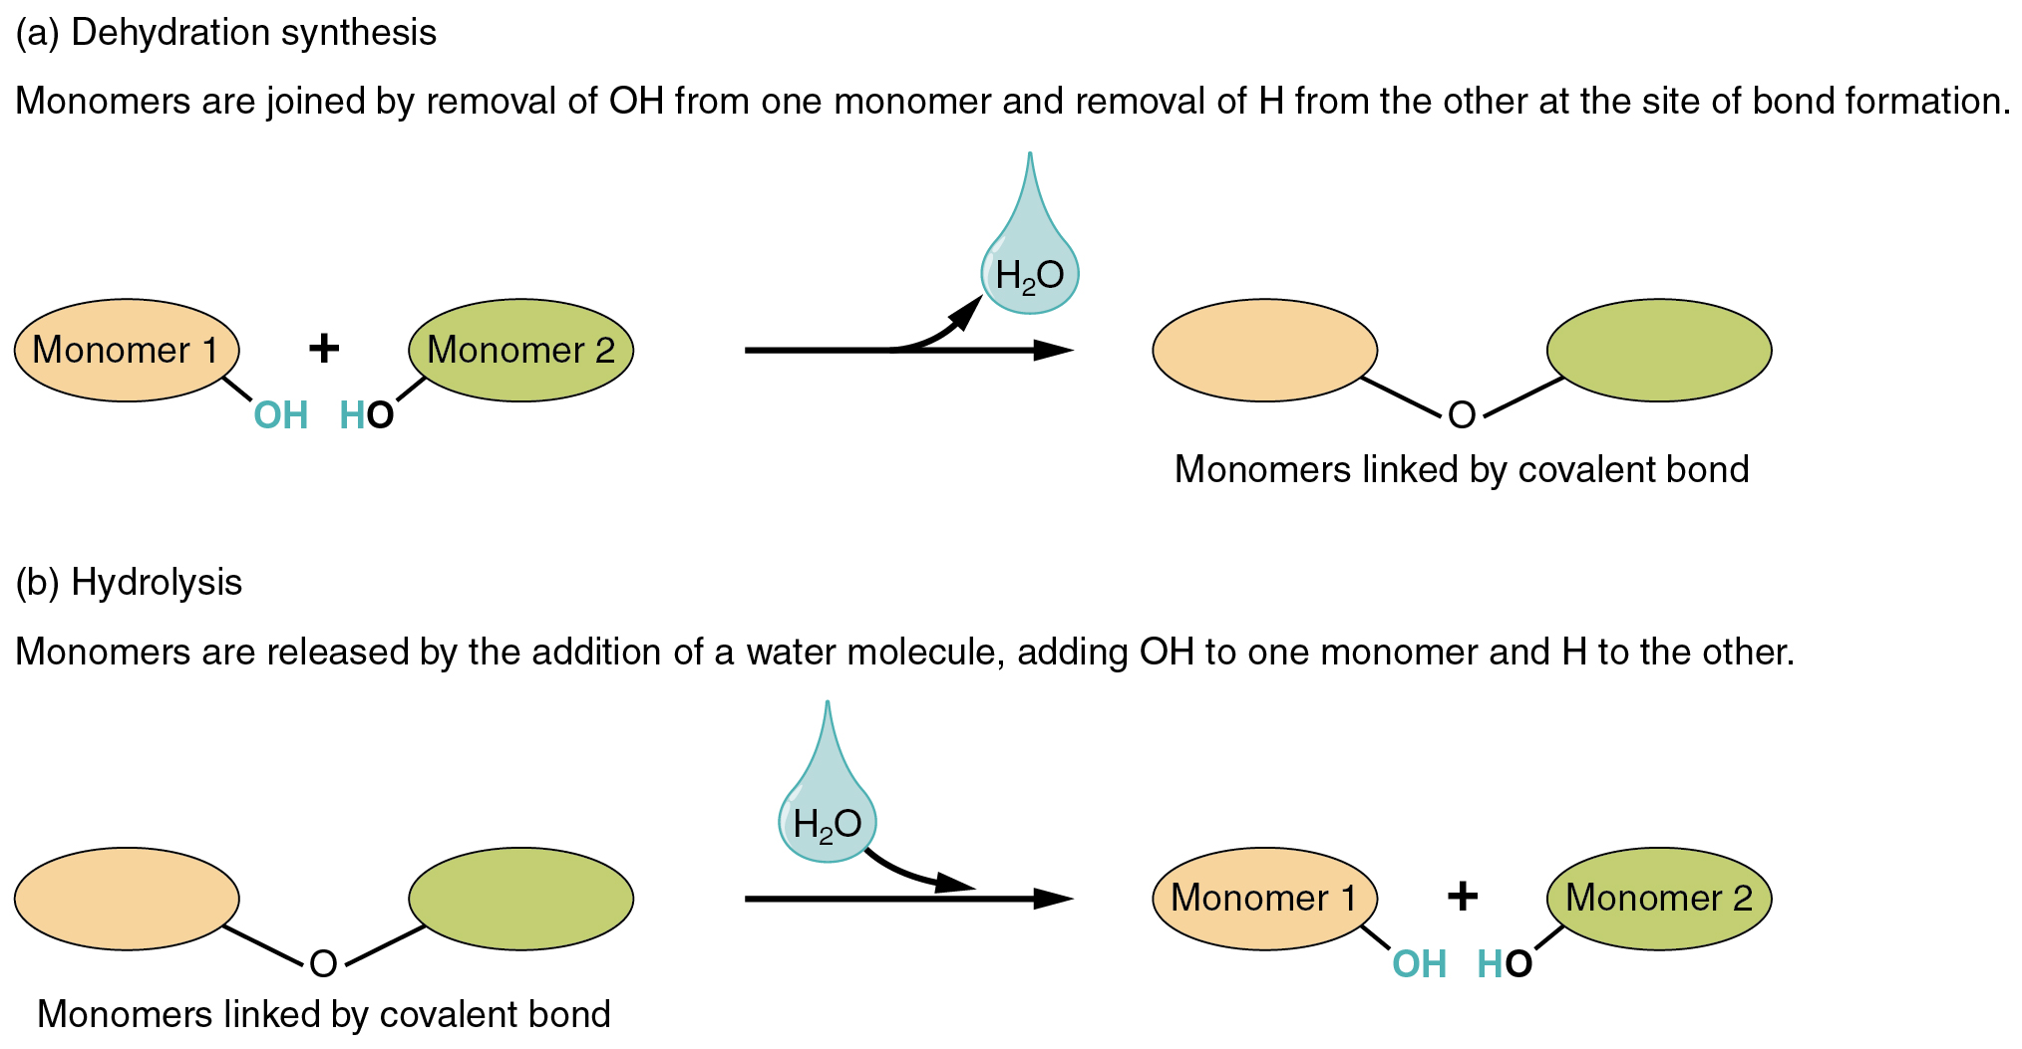
Dehydration And Hydrolysis OPPOSITES

Slide 11
Major groups of organic compounds found in living things
Carbohydrates
Lipids
Proteins
Nucleic acids
Stop for the supersize video!

Slide 12
Carbohydrates
Main source of energy for living things
Structural support for plants and some animals
Made up of C, H , O atoms
Usually in a 1:2:1 ratio
Simple Sugars: Monosaccharides
Double Sugars: Disaccharides
Polysaccharides: carbohydrate polymers

Slide 13
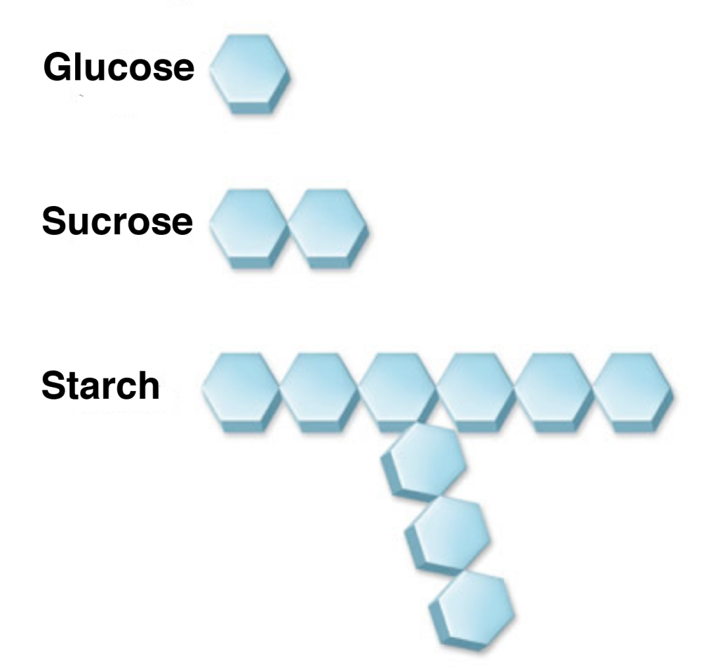
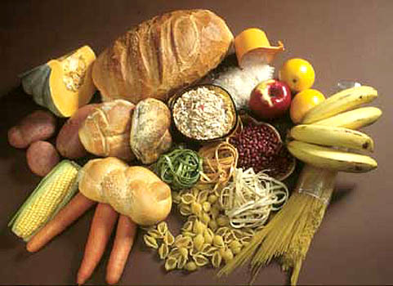
Carbohydrates are built from sugars (monosaccharides)
Monosaccharide
Disaccharide
Complex saccharide

Slide 14
Monosaccharides Carbohydrate monomers
Glucose – produced by plants by photosynthesis
Isomers: Same chemical formula different structure and properties
Campbell Figure 3.4B

Slide 15
Disaccharides Two monomers bonded together
Campbell

Slide 16
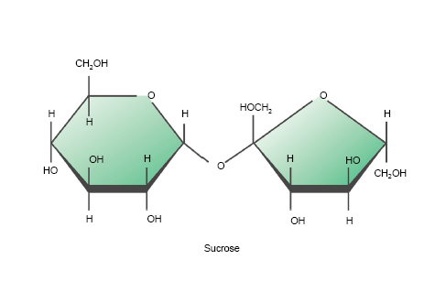
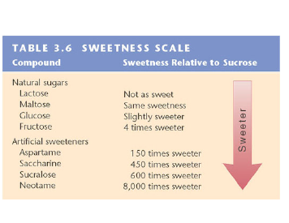
Most Common Disaccharide: SUCROSE Table Sugar Glucose + Fructose
Campbell Table & Figure 3.6

Slide 17
Simple carbohydrates: Mono- and Disaccharides
Glucose
Fructose
Galactose
Monosaccharides
Disaccharides
Sucrose
Maltose
Lactose

Slide 18
Campbell Figure 3.7

Slide 19
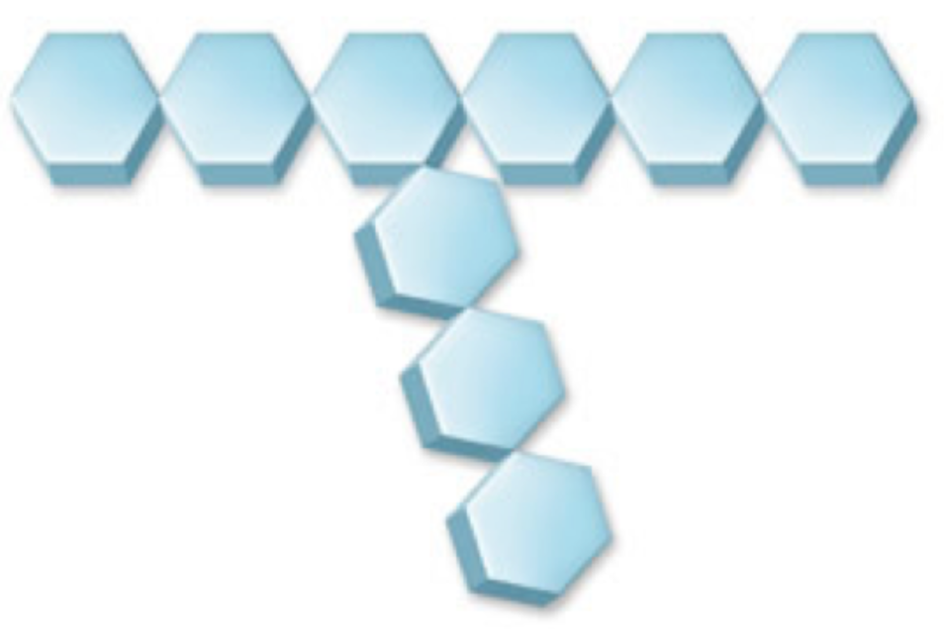
Complex carbohydrates: Polysaccharides
Polysaccharides
Starch
Glycogen
Cellulose

Slide 20
Lipids: Fats, Oils & Waxes
Large and varied group
Made up of mostly C & H atoms
Uses:
Energy Storage
Waterproofing
Structure
Hormones
Campbell Figure 3.8A

Slide 21
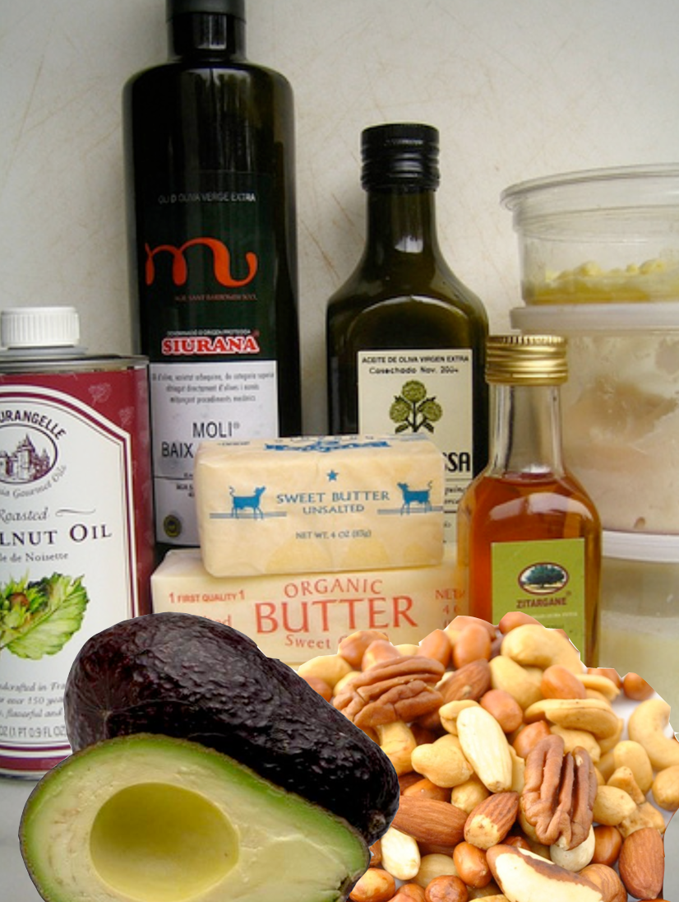
Lipids are built from triglycerides
Triglyceride
Glycerol
Fatty Acid 1
Fatty Acid 2
Fatty Acid 3

Slide 22
Fatty acids can be saturated or unsaturated
Saturated fatty acids are always solid
Unsaturated fatty acids can be
solid or liquid

Slide 23
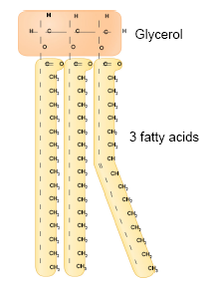
Fats continued…
Made of two kinds of molecules
Glycerol
Fatty acids
Saturated Fatty Acid:
Carbons joined by single bonds
Maximum H atoms
Unsaturated Fatty Acid:
At least one double bond between carbons in the fatty acid
Campbell Figure 3.8C

Slide 24
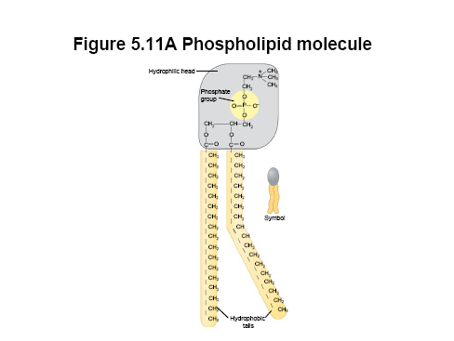
Phospholipids
Structurally similar to fats
Only has 2 fatty acids
1 phosphate group
Have
hydrophilic heads
Hydrophobic tails
Campbell Figure 5.11A

Slide 25
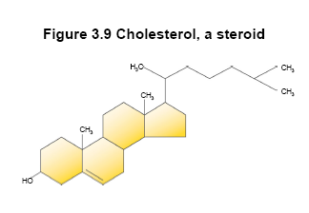
Steroids
Carbon Skeleton has:
Four interconnected rings
Different functional groups attached
Cholesterol
Molecule from which other steroids are made.
Campbell Figure 3.9

Slide 26
Proteins
Macromolecules containing: C, H, O, N
Functions:
Structural support
Storage
Transport
Defense
Signaling from one part of an organism to another

Slide 27
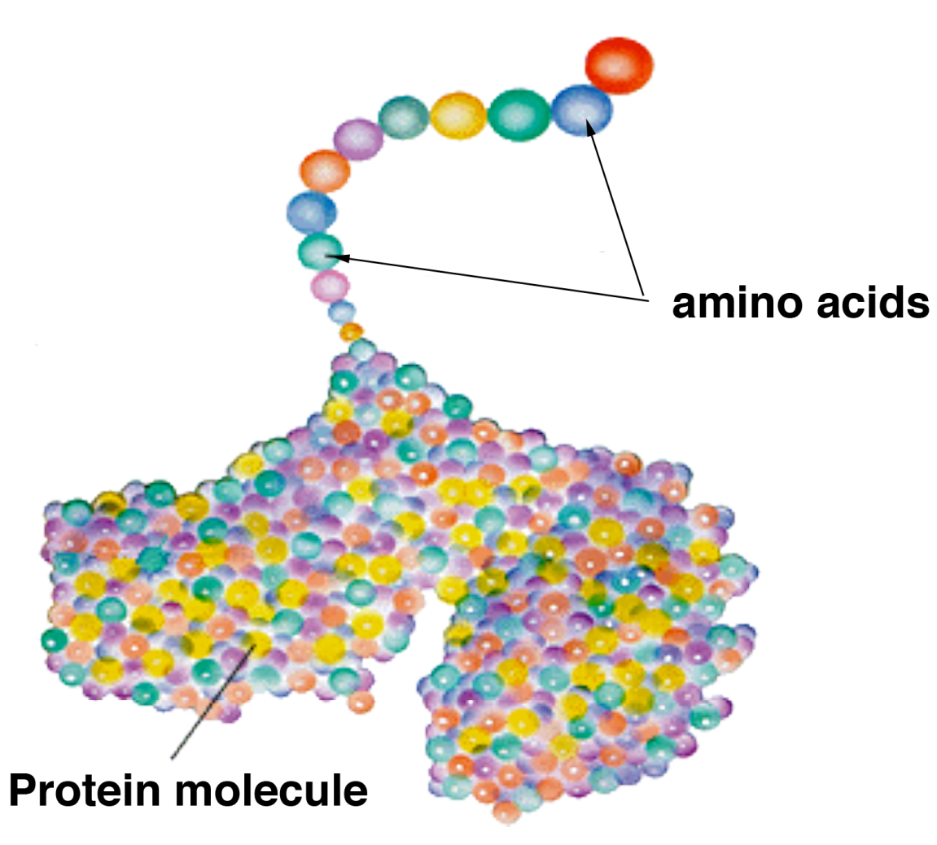
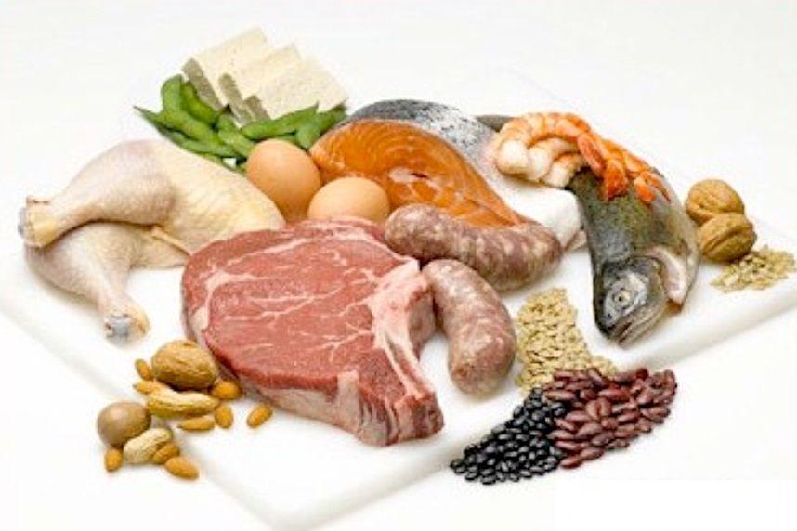
Proteins are chains of amino acids

Slide 28
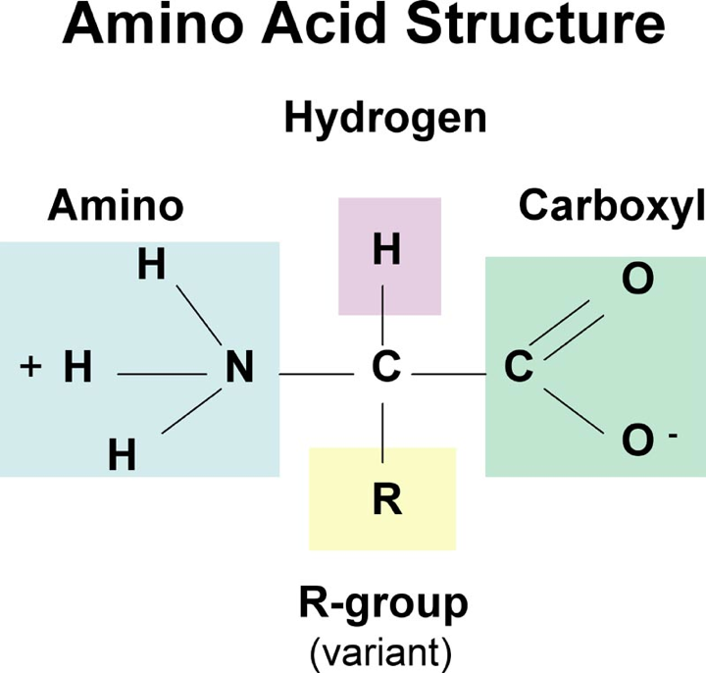
The body uses 20 different kinds of amino acids
Each amino acid has a different ‘R’ group

Slide 29
Monomers of Proteins are Amino Acids There are 20 kinds of Amino Acids
Campbell
Notes:
R

Slide 30
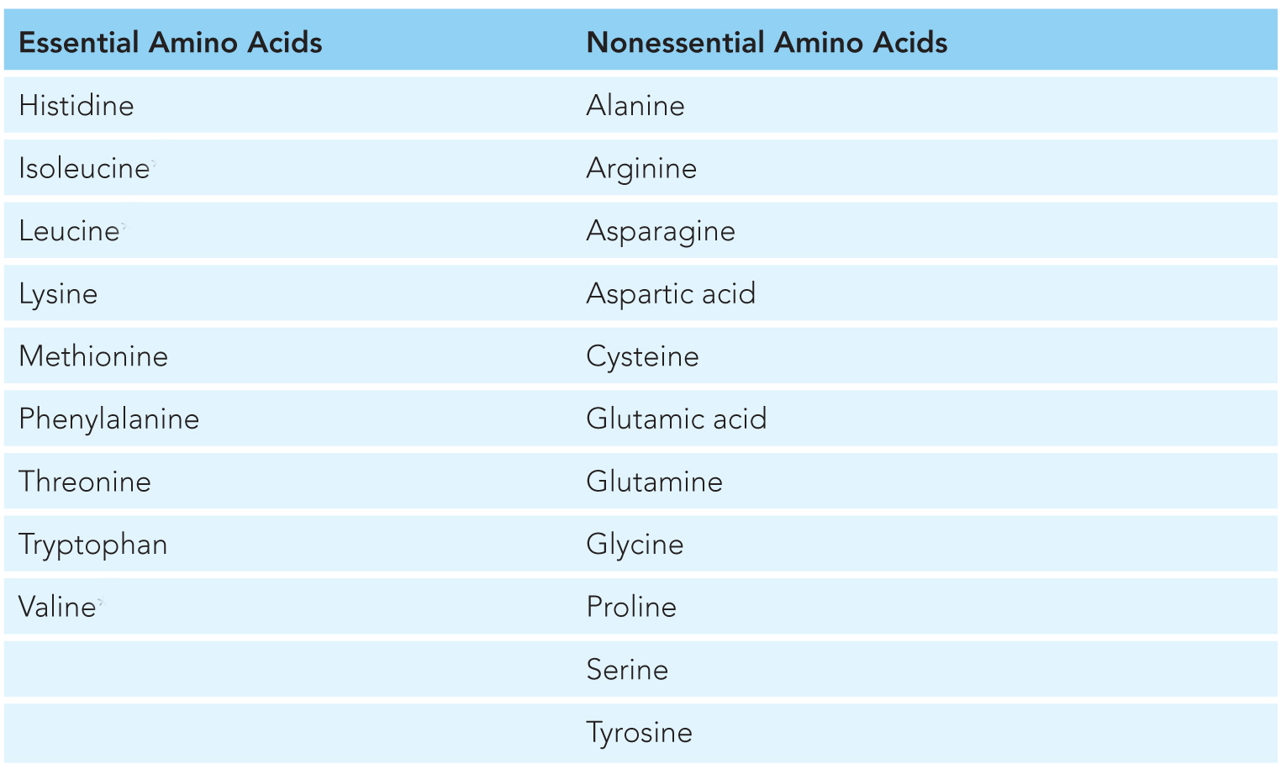
The body can make some amino acids but not all
Essential amino acids must be obtained from the diet

Slide 31
The Peptide Bond
Dehydration synthesis occurs between
A carboxyl group of one amino acid
Amino Group of another amino acid
Campbell

Slide 32
Nucleic Acids
Macromolecules containing H, N, C & P
Store & transmit Genetic Info.
Two kinds:
DNA
RNA
Monomers: Nucleotides
Phosphate group
Nitrogenous Base
5- carbon sugar

Slide 33
Campbell Figure 3.16A

Slide 34
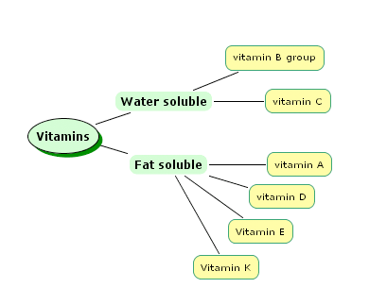
Micronutrients: Vitamins
Easily destroyed by cooking
Can be stored in fat
and become toxic.

Slide 35
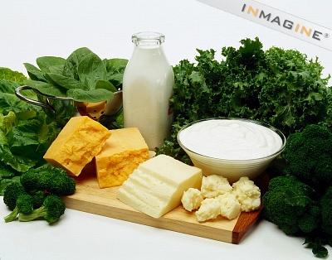
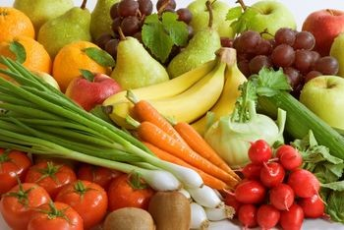
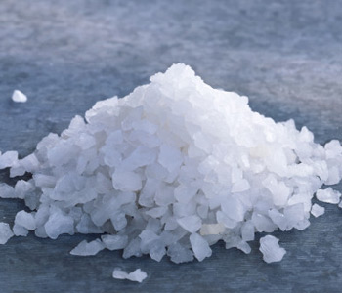
Micronutrients: Minerals
Calcium - Bone health, muscle contraction, nerve function
Potassium - Muscle contraction, nerve function
Sodium - Blood pressure and nerve function

Slide 36
Water
Polar Covalent molecule
Hydrogen bonding attracts water molecules to one another
Properties:
Adhesion
Cohesion
Expands when frozen
High heat capacity
High vaporization point

