Slide 1
Enzymes – ‘catalytic proteins’
What do enzymes do, and how?

Slide 2
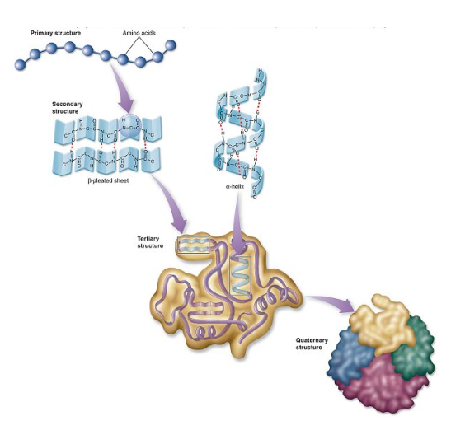
Enzymes – what are they?
They are proteins.
Each enzyme’s function is based on its shape and structure.

Slide 3
Function – What do they do?
Enzymes act as catalysts
They control chemical reactions in living organisms by lowering the activation energy required. (usually speeding the rxn up!)
Some real life examples:
Digestion, molecule production, storage/release of energy.
Enzymes are involved in nearly all metabolic processes.

Slide 4
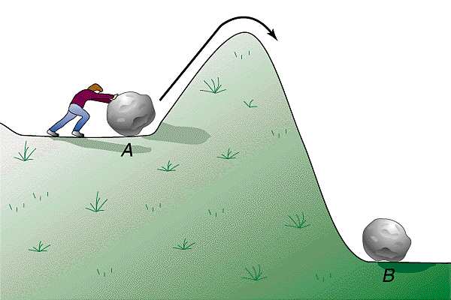
Substrates and Products
Enzymes allow substrates to chemically change into products.
Reactants → Products
Substrate – the ‘reactant’ (A in pic)
Product – the result (B in pic)
Enzymes will lower the energy required to START a reaction
(aka activation energy)

Slide 5
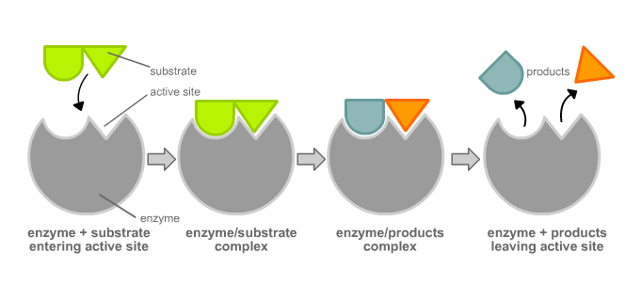
The Lock-and-Key Analogy
Enzymes bind to their substrate like a lock fits with its key
The binding site = the ‘active site’

Slide 6
Examples and a video clip!
http://highered.mcgraw-hill.com/sites/0072495855/student_view0/chapter2/animation__how_enzymes_work.html
Generally, enzymes work with specific substrates. EXAMPLES:
Lactase – catalyzes breakdown of lactose
Lipase - lipids
Peptidase – peptide bonds in proteins
Catalase – hydrogen peroxide
Enzymes are REUSEABLE (over and over…)

Slide 7
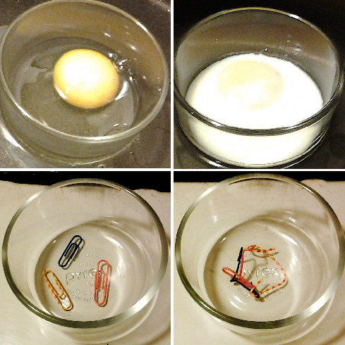
Denatured Enzymes
Enzymes work unless exposed to:
Extreme temperatures
Extreme pH (acidic or basic)
Interfering chemicals
They become ‘denatured’:
These eggs, once cooked, have had their proteins denatured.
A change in shape that prohibits an enzyme from binding with substrate
Result: no reaction
These paper clips represent the changes in shape that occurs during denaturing.

Slide 8
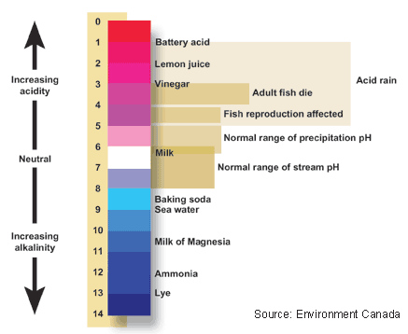
pH
A measure of acidity or basicity (alkalinity)
Cell environments must maintain a safe pH balance for proper functions especially enzyme function!)
0-14 scale
0-7 acid
7-14 base

