Slide 1
Characteristics of Life
ROGER

Slide 2
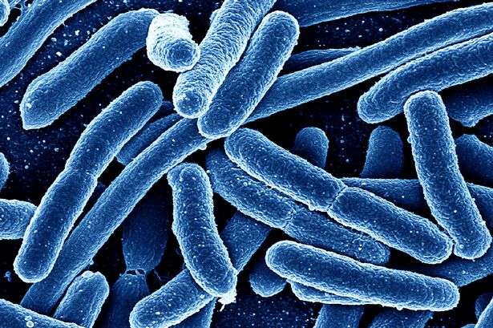
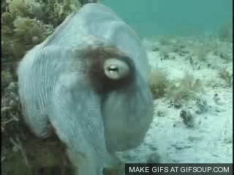
Essential Characteristics
Abiotic vs. Biotic
ROGER
Reproduction
Organization
Growth/Development
Energy synthesis
Respond to Environment

Slide 3
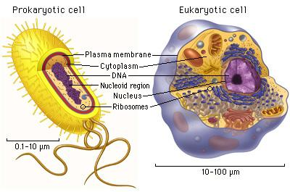
Reproduction and Organization
Asexual vs. Sexual reproduction:
The creation of offspring for the continuation of a spp. (species)
What is a species?
Group of organisms that produce “viable” offspring
Cell Types, Specialization, DNA:
Unicellular vs. Multicellular
Prokaryotic vs. Eukaryotic
Cell → Tissues →_____→_____→______

Slide 4
Growth/Development & Energy
Growth vs. Development
Increase in mass, or change in shape
Maturation (usually associated with life stages, or a chemical basis)
Energy
“Metabolism” – the sum of energy conversions
Heterotroph and Autotroph
Photosynthesis, Cell Respiration, Chemosynthesis

Slide 5
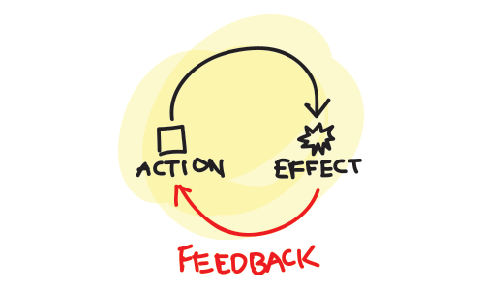
Respond to the Environment
Stimulus --> Response
Biotic factors adjust to
abiotic factors
Homeostasis: a balanced
internal and external environment.
Adaptation: A response
or change over time.
Evolve: Organisms cannot evolve, only a species.

Slide 6
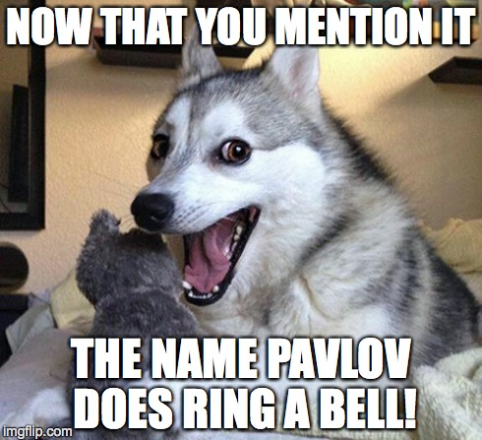
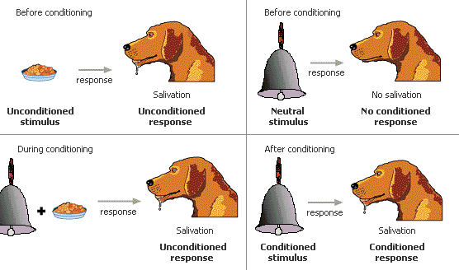
Classical Conditioning

