Slide 1
Cancer

Slide 2
Write 2-3 sentences for each question.
What is cancer? Hint: In what way could it involve the cell cycle?
How can we consider cancer a genetic disease?
What factors affect the likelihood of developing cancer?
How is cancer fought and treated?

Slide 3
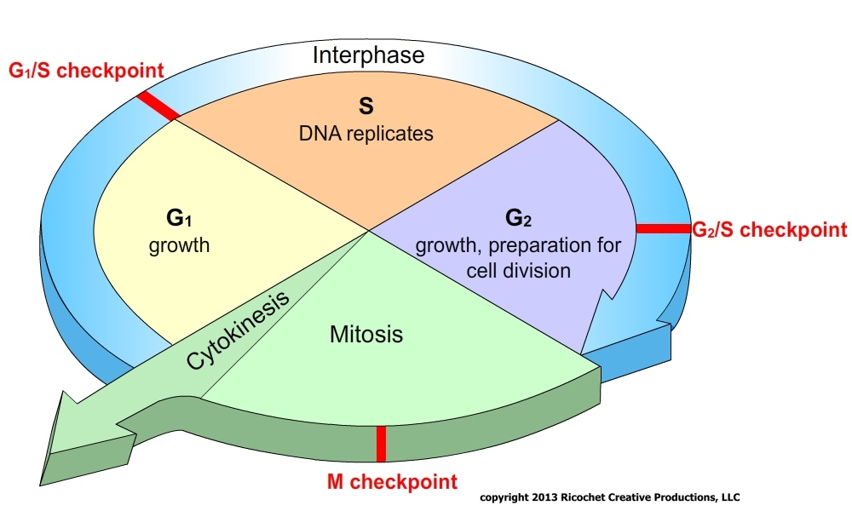
What is cancer? Hint: In what way could it involve the cell cycle?

Slide 4
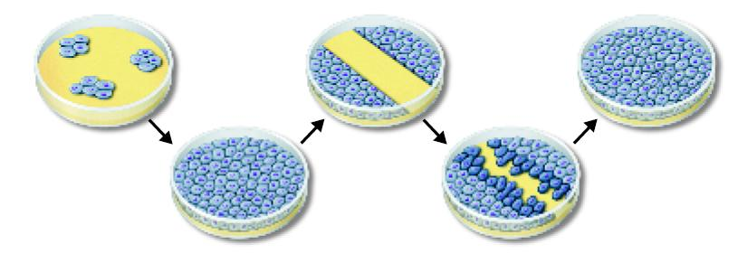
Contact inhibition fails to limit growth in cancerous cells.
Normally, cells in a petri dish will growth until limited by space:

Slide 5
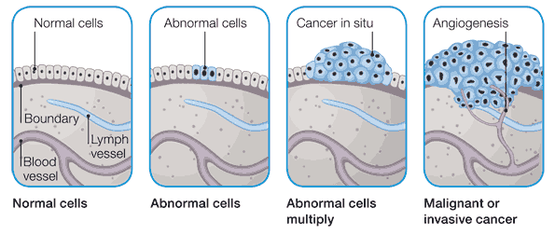
Various Stages of Development
Mutation proliferation survival/invasion metastasis
ONCOGENES – causes cancerous growth
Notes:
In situ – it is localized and has not invaded surrounding tissues.
Malignant or invasive cancers have spread through various means to surrounding tissues and deprive them of nutrients, thus harming tissues.

Slide 6
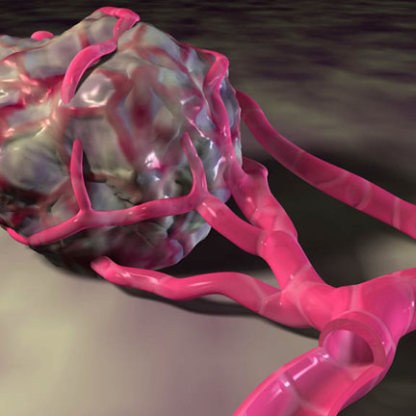
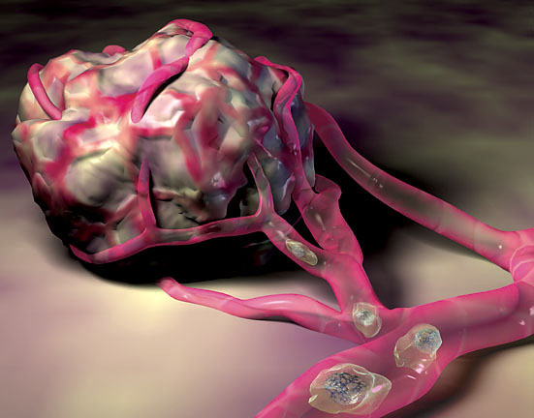
Describe (2-3 sentences) how tumor A and its surrounding blood vessels is different from tumor B. What might these differences suggest?
Tumor A Tumor B

Slide 7
How can we consider cancer a genetic disease?

Slide 8
What factors affect the likelihood of developing cancer?
Radiation therapy
Atomic blasts
Nuclear power plants
Radon found in indoor air
Radon found in outdoor air
Food irradiation
UV
Electric blankets
TV
Powerlines
Computer screens
Lightbulbs
Radar guns
Cell Phones
Mircrowaves
Nutrasweet (Aspartame)
High fat diet
Obesity

Slide 9
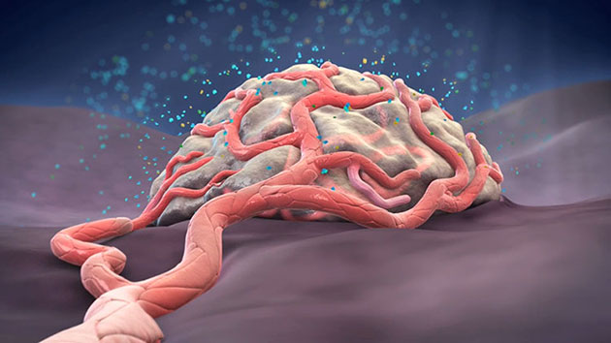
How is cancer fought and treated?
Surgery
Radiation
Chemotherapy
Anti-angiogenic drugs
Anti-metastatic drugs

Slide 10
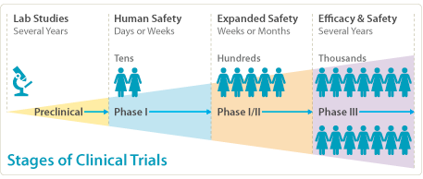
Clinical Trails
Stage I
Stage II
Stage III
Reasons for trails:
treatment options
identification and diagnosis
Prevention
management of symptoms
Management of treatment side effects
Notes:
Stage I: to find a safe dosage, how to administer the dosage, and how it affects the body
Stage II: to explore how the treatment effects a certain cancer, further see how it affects the body
Stage III: explore how the treatment compares to current treatments for cancer

